Slide 1
Our Pathway to Net Zero
Annabel Harford
Environmental Manager
Avon Fire & Rescue Service

Slide 2
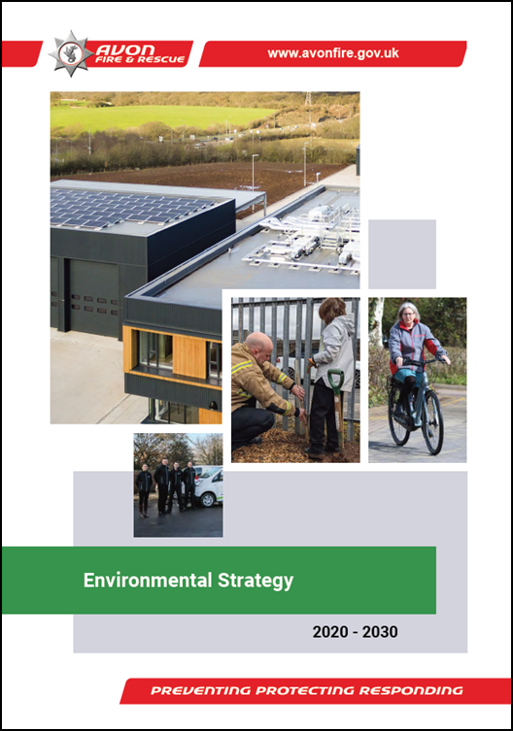
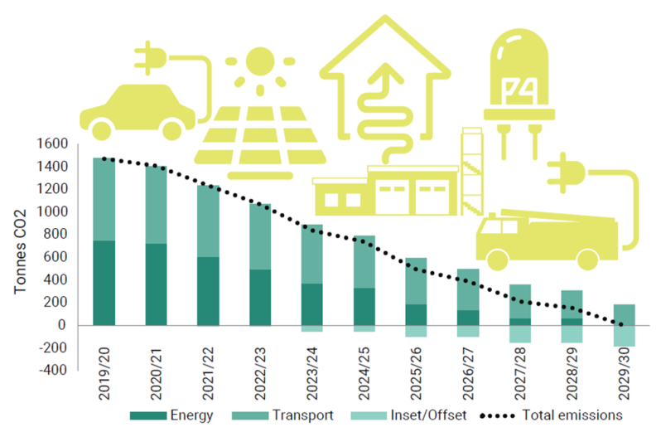
Policy context
Declared Climate & Ecological Emergencies
10 year Environmental Strategy
Committed to Net Zero by 2030
Aligned with our 4 local authorities

Slide 3
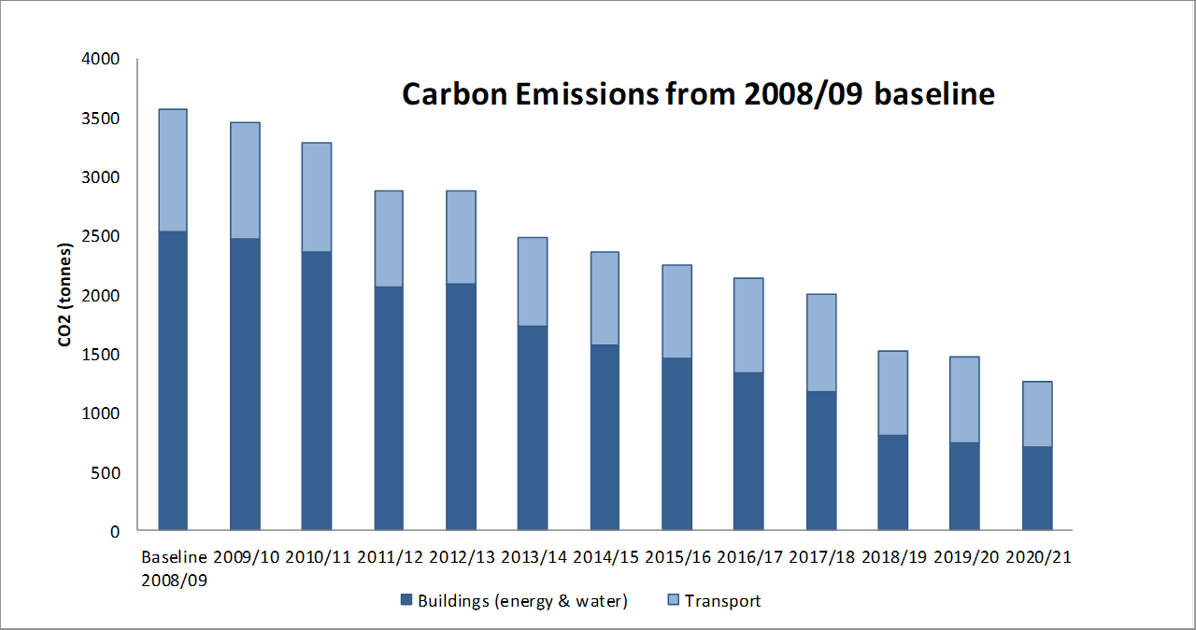
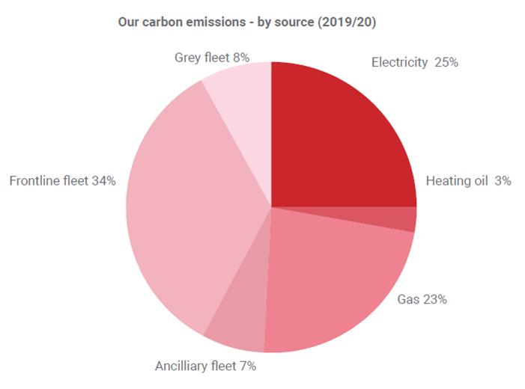
Progress to date…

Slide 4
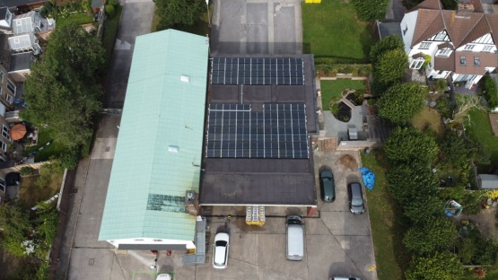
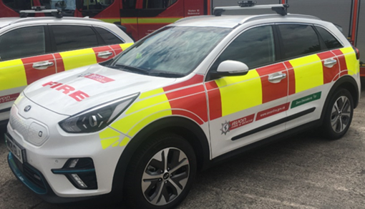
Carbon reduction measures
Energy efficiency & renewables
100% renewable grid electricity
Water efficiency
£820k Public Sector Decarbonisation Grant
Telematics
Zero emissions fleet
Electric charging infrastructure
Operational policy changes
Electric Vehicle & Cycle to Work schemes

Slide 5
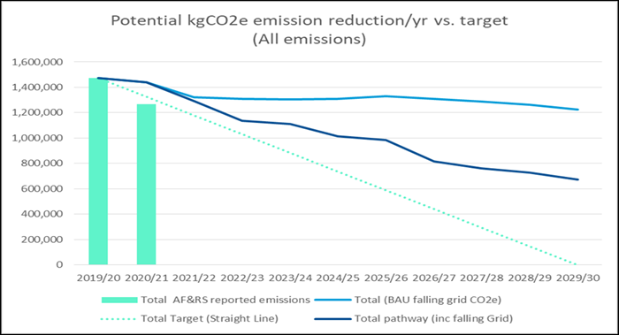
Our journey to Net Zero…?

Slide 6
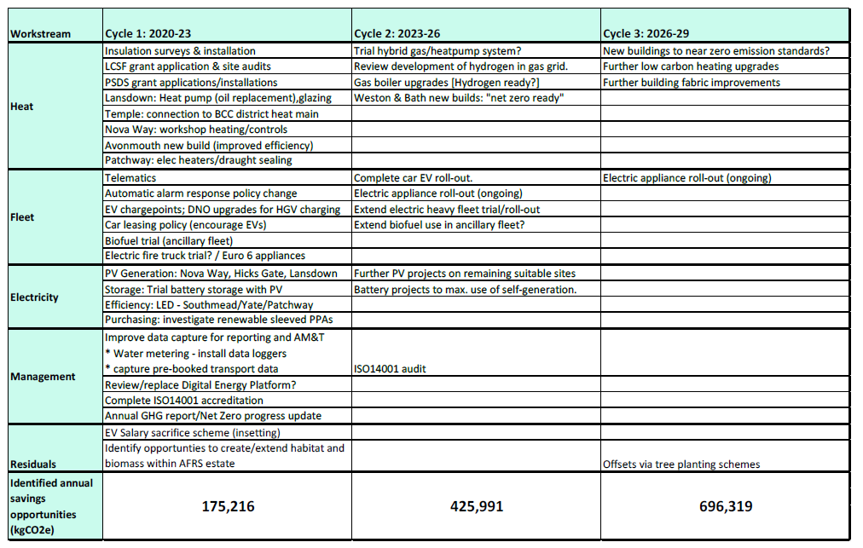
Emission reduction workstreams per three-year cycles

Slide 7
Success factors
Boldness of vision
Centralised co-ordination
Internal allies
Support from leadership
PSDS
External support
Sharing experience with others e.g. ESESG colleagues!
Challenges
Old buildings & asbestos
Limited electrical capacity
Predominantly diesel fleet
Salix timescales
Limited zero emissions HGVs
Conflicting priorities
Internal resources

Slide 8

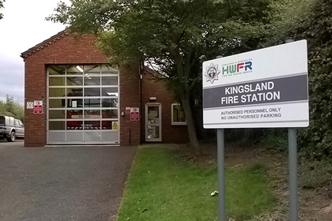

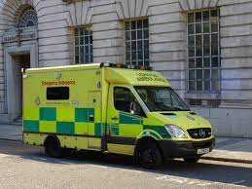
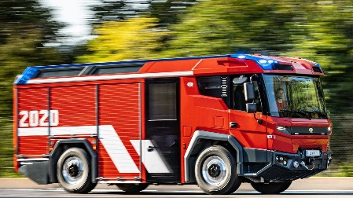
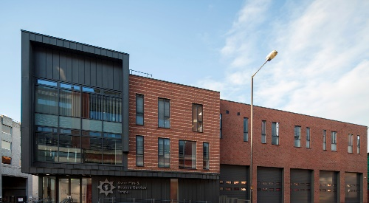

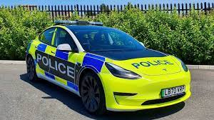

Same Journey, Different Landscape = Unique Roadmaps

