Slide 1
Sustainability In Policing – Update for ESESG
Jon Rawling, Regional Commercial Director BlueLight Commercial
11th November 2021

Slide 2
Update on UK Policing Initiative

Slide 3
Workstream Terms of Reference Summary
Sustainability Strategy & Policy
Objectives
Develop sustainability guidance, policies, strategy for carbon plans
Develop Overarching roadmap plan for carbon reduction
Develop standard method for carbon measurement
Apply social value standards and SDGS
Develop governance to link groups together for oversight
Share best practise process is for sustainability plans
Give advice guidance for policies required to be implemented
Communication of pilots
Estates and Energy
Objectives
Develop building of future design / building standards to drive carbon neutral reduce waste and utility usage
Develop carbon baselining data and footprints
Develop energy strategy for sustainable use
Develop roadmap for new and existing buildings
Link with transport team to provide infrastructure requirements
Establish and influence grant opportunities
Communicate best practices
Transport and Charging Infrastructure
Objectives
Develop roadmaps for Fleet and Aviation aligned to carbon reduction plans with larger targets
Develop infrastructure standards for electric and hydrogen
Develop technology plan for gaps in Fleet. Identify behavioral and cultural changes required
Standard charge is required to implement new plans
Communicate best practises
Develop charging point strategy and electrical infrastructure upgrades
Understand grant options available
Sustainability Governance Board

Slide 4
Groups with Key Independencies
Transport and Charging Infrastructure
ESESG
(Emergency Services Environmental & Sustainability Group)
NPEG
BlueLight Commercial & Procurement Teams
Sustainability Strategy & Policy
Estates and Energy
NPAS
NAPFM

Slide 5
Data Collection to Create Roadmap
Policing requires first step of scopes 1 and 2 full data to understand baseline and set appropriate targets
Central data collection via benchmarking estates and energy CIPFA, BLC/NAPFM fleet, NPAS/BLC
Use CIPFA benchmarking for estates and energy data
Telematic data to assist with fleet data
Procurement agree to support policy on contracts greater than £5m for scopes 1 and 2 providers
Reporting process and review required to document progress (see Police Scotland report as example)
Guidance document to be created for police and crime plans and support policing vision 2030
Critical success factor data access via telematics, carbon reduction plans, estates strategies

Slide 6
Options to Create Carbon Reduction Plan
Strategic roadmap from workstreams
Sharing and Learning sessions
Public Sector Network https://www.carbontrust.com/resources/public-sector-network
Local Detailed Plans
Use of Consultants - better to use one single source/ develop framework, standardised specification
Currently following providers have been used in policing: Ricardo Environmental, Twelvetrees Consulting, Carbon Trust, All Wales Sustainability Group, Essentia Trading Limited, Aecom, Buro Happold, Resilience Sustainable Solutions, Michael Carr consulting
Government PPN suggest the following: Carbon Trust, Carbon Smart, Ricardo-AEA, CDP partners, Waste Resources Action Programme (WRAP), Greenstone, Ecometrica, Anthesis Group, IEMA, Verco, Loreus, WS Group
Use groups such as NAPFM, NPEG, ESESG, NPAS to get common practices and share plans

Slide 7
Short term supporting actions for BlueLight Commercial

Slide 8
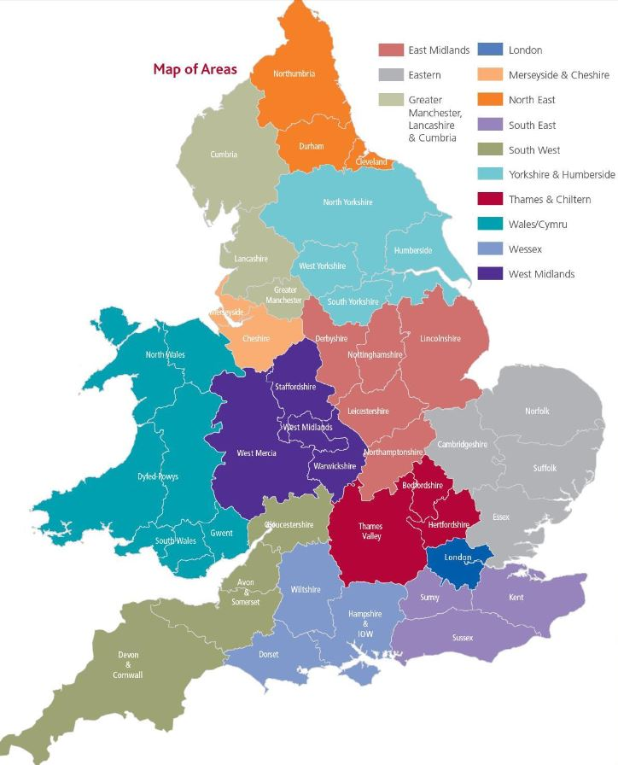
Carbon Reduction Plan
43
9
8
14
12
Still Waiting
Nil Activity
Developing Strategy
CRP In Place
21%
19%
33%
27%
Plan | Q3 | Q4 | Q1
Baseline | Collate | Complete
Methodology & Validation |  | Share
Carbon Reduction Plan | Review |  | Complete
1
3
2

Slide 9
Commercial Activity
Short term
Routes to market for EV charging today
Preferred consultant for Roadmap development
Broadening of Fleet contract suppliers to widen choice for Electric, Hybrids and cleaner diesel vehicles
Investigation of Sustainble power supplies and PPA’s.
Investigation and best practice sharing on Zero waste to landfill approaches.

